Slide 1
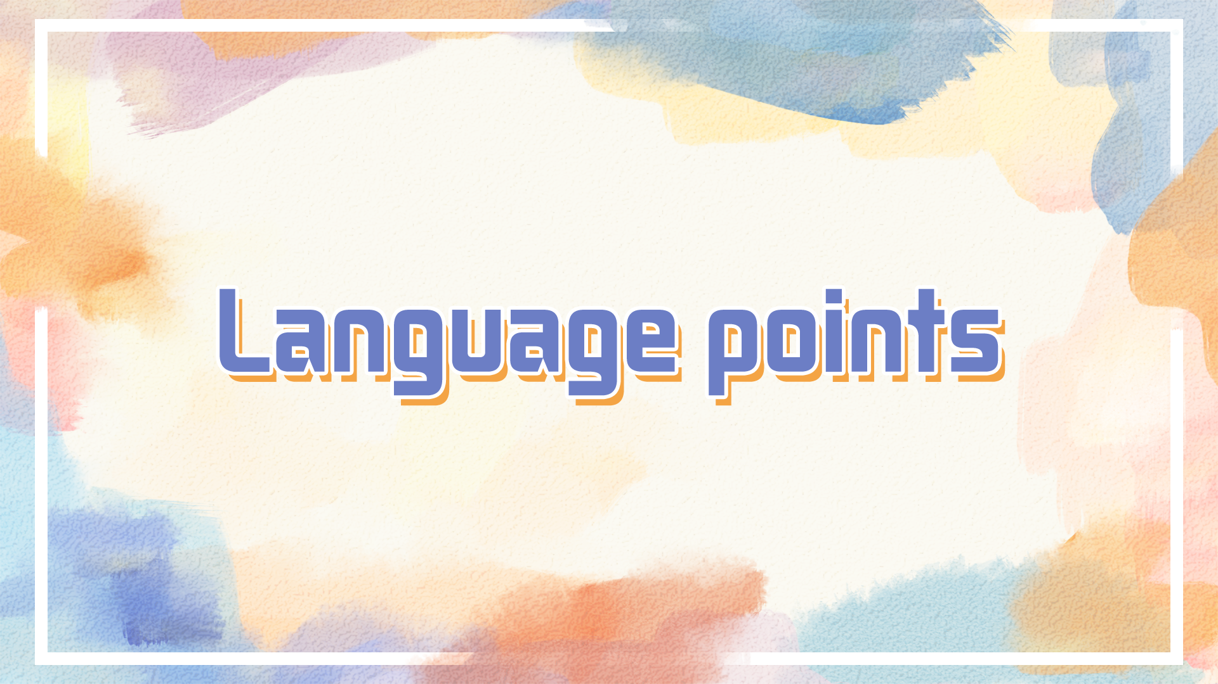

Slide 2
be awed by sth 敬畏某事物
We watched in(with) awe/in awed silence.
She ___________ __ ____ at the great stones.她惊叹地盯着那些巨石。
While Diana was/stood in awe of her grandfather, she adored her grandmother.
她第一次看到金字塔时，就充满了敬畏和好奇。
Her ____ _________ of the pyramids _____ ____ ____ ____ and curiosity.
adj. 令人惊叹的 awesome
civil war/ civil law
civilize 教化
gazed/stared in awe
first sight/view
filled her with awe
civilian 平民
civilized societies / city / a civilized conversation
Notes:
充满敬畏的人群安静地聆听
'It's magnificent,' she whispered in awe.
“真是壮丽。” 她小声地惊叹道。
敬畏admire and be frightened of ...

Slide 3
preserve the peace
维护某人的名声 维护和平
保护濒危物种不致灭绝
Ice helps to ________ ______ (保存食物).
There was a demand for ice for food ____________.
well _________ food
The juice contains no artificial preservatives.
The police are the preservers of law and order.
conserve energy / the forestes
a nature reserve
The Gulf has 65 per cent of the world's oil reserves.
A room with a balcony overlooking the sea was reserved for him.
preserve one’s reputation
preserve endangered species from extinction
preserve food
preservation
preserved
preserve
Notes:
警察负责维持治安。
节省自然资源

Slide 4
in urgent need of protection 急需保护
protection is ________ needed.
an ______ ______ ______ information 紧急呼吁提供信息
a matter of the utmost ________
He has repeatedly urged the government to take action.
He has repeatedly urged that the government (should) take… 虚拟语气
“Why not give it a try?” she urged (him).
She could hear him urging her on as she ran past.为……加油，鼓励
I had a sudden ______ to hit him.
urgently
urgent appeal for
urgency
urge
Notes:
敦促，力劝

Slide 5
The machines start to wear down, they don't make as many nuts and bolts as they used to.
wear sb down / wear down one’s will/resolve
He ______ ____ two pairs of shoes.
The kids have totally _____ me out.
an old pair of worn jeans
Our products must stand wear and tear.
For many the philosophy was merely a fashion, and the novelty soon wore off.
Now that the initial shock was wearing off, he was in considerable pain.
最初的震惊渐渐过去之后，他感到疼痛难忍。
wore out
worn
weary / worn
tattered, shabby, in rags, ragged, patched
wane, melt away
Notes:
消磨某人的意志 overcome someone or something by persistence 瓦解我的决心
筋疲力尽Before the race, he is fine. But afterwards he is worn out. 赛前他状态很好，赛后就筋疲力尽了。
be weary of
磨损 Our products must stand wear and tear.
我们的产品必须经久耐用。
'A passport to a brighter future': it sounds like a worn-out advertising slogan, but for once the cliche has substance.
逐渐消失 enthusiasm, excitment, pain
While his interest in these sports began to wane
既然，由于

Slide 6
ruin him/ his life/ the trip/ his shoes / the country
这个错误断送了他得到这份工作的机会。
The mistake ruined his chance of getting the job.
The cottage gradually fell into ruin. 衰落，衰败
Years of fighting have left the area in ruins.
这件丑闻让他的名誉受损。The scandal ____ ___ ________ ___ ____.
在可怕的15秒钟之内，一座大城市就沦为一片废墟。
In fifteen terrible seconds a large city lay/was (left) in ruins / be reduced to ruins / fell into ruin.
ruins of ... / remains of ...
left his reputation in ruins
Notes:
消磨某人的意志 overcome someone or something by persistence 瓦解我的决心
筋疲力尽Before the race, he is fine. But afterwards he is worn out. 赛前他状态很好，赛后就筋疲力尽了。
磨损
'A passport to a brighter future': it sounds like a worn-out advertising slogan, but for once the cliche has substance.
糟蹋了鞋
经年的战事已经使得这个地区满目疮痍。
这件丑闻使他身败名裂。
...的废墟

Slide 7
on purpose
deliberately / purposefully / intentionally / knowingly
accidentally
by accident/ by chance/ unexpectedly/ unintentionally
a conflict between two parties over ownership of the land
She found herself in conflict with her parents over her future career.
John often comes into conflict with his boss.
The government has done nothing to resolve/settle the conflict over nurses' pay. 解决关于护士工资的冲突
内心的矛盾
conflict of interest(s)
His opinions ________ ________ mine.
__________ goals 矛盾的目标
inner/internal conflict
利益的冲突
conflict with
conflicting
Notes:
与……产生争执

Slide 8
【语境应用】完成句子。
1) Your statement is ________ ________ ________ ________ ________ ________ ________ ________ (与其余证据有矛盾).
2) John often ________ ________ ________ ________ ________ ________ (和他的老板发生争执).
3) These results ________ ________ ________ ________ (与早期的发现相矛盾).
4) ________ ________ ________ ________ ________ ________
(这两国之间的一次冲突)could easily spread across the whole world.
in conflict with the
rest of the evidence
comes into conflict with his
boss
conflict with earlier findings
A conflict between the two countries

Slide 9
This is a payment made to every individual irrespective of employment status.
He achieved celebrity status through his role in a popular sitcom.
low-status jobs
很高的社会地位
What is the current status of our application for funds?
update my status on Wechat
maintain/restore the status quo
维持现状/恢复原来的情况
have a high social status
Notes:
这是向每个人支付的款项，无论就业状况如何。职业身份
sitcom (situation comedy)
地位低下的工作
进展情形
status updates

Slide 10
repairable / irreparable
irreplaceable
She demanded that he _____ an apology.
demand to do sth
demand for sth
Their children are at high risk ____ developing the disease.
Children are more at risk _____ the harmful effects of alcohol.
jazz, rock and the like 诸如此类的(音乐)
She didn't want to associate with the likes of me. 和我一样类型的
We all have different ______ and _______. (好恶)
make
of
from
likes
dislikes
Notes:
insist
old favourites

Slide 11
ecological
ecologist
增强信心
give sth/sb a boost 推动某事/给某人以鼓舞
the next item _____ the agenda 议程表上的下一项
In our company, quality is high on the agenda.
我们公司高度重视质量
对政府来说，遗产保护是当务之急。
For the government, heritage protection is at the top of the agenda.
= in urgent need
boost confidence
on
Notes:
It did give me a boost to win such a big event. 赢得如此重大的比赛确实使我信心倍增。

Slide 12
仅仅只是一想到
The mere/very thought of lice makes my head itch.
再一想
On second thoughts, maybe I won’t apply for the job after all.
He dismissed the rumor without _____ ______ ______. 毫不犹豫
在片刻的考虑/犹豫之后
陷入沉思
give thought to sth = give sth thought 认真考虑某事，思考某事
别把这事放心上
读出某人的心思
a second thought
after a moment’s thought
lost/sunk/deep in thought
Don’t give it another thought
read one's thoughts
Notes:
lʌɪs
驳斥这个谣言
give it a/some thought

Slide 13
nail n. / v. fasten sth to sth with a nail
The windows were all nailed shut. / hammer the nail in
nail one's eye(s) on sth 死死盯住某物
He nailed a victory in the semi-finals.
She nailed it on her second jump.
He simply looked mean and (as) hard/tough as nails. 冷酷无情
It would be useful if you could nail down the source of this tension.
做出决定，敲定
It's been a nail-biting couple of weeks waiting for my results.
这几个星期等结果，弄得我坐立不安。
他在半决赛中获胜。secure
Notes:
窗户都钉死了。
secure
她在第二跳中表现出色，赢了比赛。

Slide 14
a panel discussion 专家小组讨论
a control panel 控制面板
a glass-panelled door 镶玻璃的门
specialize in
I'd assess your chances _____ low.
The committee assesses ________ a building is worth preserving.
The legal costs have been assessed _____ £75,000.
a detailed __________ of the risks _________ (involve)
as
whether
at
estimate
assessment involved
evaluation
Notes:
专门研究，专攻某事
该委员会评定一栋建筑物是否值得保存。

Slide 15
He collapsed following a vigorous exercise session at his home.
She arrived home exhausted and barely capable of showering before collapsing on her bed.
The peace talks were on the verge/brink of collapse.
The peace talks were about to collapse.
She collapsed in tears.
the collapse of law and order
a state of mental collapse
Share prices collapsed after news of poor trading figures.
The table collapses for easy storage.
faint, pass out
sit/lie down because of tiredness
break down
暴跌
fold
Notes:
崩溃大哭
治安的瘫痪
精神崩溃
这个桌子可折叠起来方便存放

Slide 16
consultation
The plans were drawn up __________________________ engineers.
与……(仔细)磋商后
I need to consult my teacher about changing my course.
a consulting engineer 顾问工程师
a __________ on economic affairs 经济事务顾问
a management consultancy 管理咨询公司
in (close) consultation with
refer to
consultant
Notes:
崩溃大哭
治安的瘫痪
精神崩溃
这个桌子可折叠起来方便存放

Slide 17
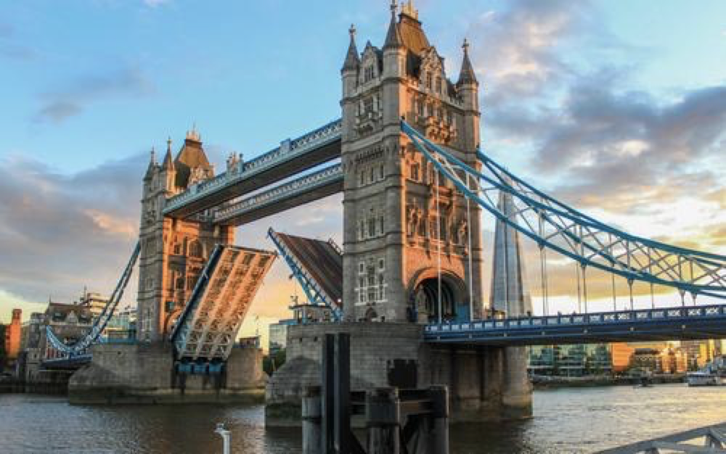
A large light was suspended from the ceiling.
Production has been suspended while safety checks are carried out.
suspend judgement 暂不判断
The introduction of the new system has been suspended until next year.
The police officer was suspended while the complaint was investigated.
a two-year suspended sentence
The fight lead to his _________ ________ school
nail-biting suspense
a suspension bridge
suspension from
Notes:
悬挂
停止
暂缓
暂停职务
两年缓刑
停学
suspense / keep us in suspense 悬疑，对即将发生的事的担心，焦虑，兴奋
余额不足 点击充值
扣人心弦的悬念
一座悬索桥

